Slide 1








Digital Marketing
WORKSHOP
By Saloni Shrestha

Slide 2

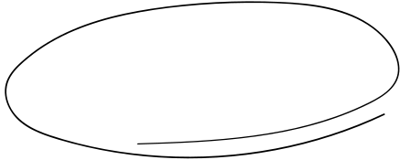

Contents
1
4
INTRODUCTION
WHO CAN BENEFIT FROM DM
2
5
HOW TO LEARN
SOCIAL MEDIA MANAGEMENT
3
6
TYPES
Q&A

Slide 3


Introduction
Digital marketing is a way of advertising and promoting products or services using the internet and electronic devices like computers and smartphones. It involves various strategies, such as optimizing online content for search engines, using social media platforms, and sending targeted messages through email.

Slide 4


SOCIAL MEDIA MANAGEMENT
SEARCH ENGINE OPTIMIZATION
CONTENT MARKETING
EMAIL MARKETING
PPC AND ANALYTICS
TYPES

Slide 5


How to learn??
Online Course
practical Project
Read Blogs
Networking

Slide 6








Who can be Benefit ?
job Seekers
Students
Business owner
Startup

Slide 7










Social Media Marketing
Social media marketing is a powerful strategy that utilizes various social media platforms to connect with and engage a target audience.

Slide 8


Things to be consider
Define Your Objective:
Know Your Audience:
Choose the Right Platform:
Craft a Compelling Caption
Visual Appeal
Hashtags

Slide 9

Thanks!
www.reallygreatsite.com

